Slide 1
Unit 3
Arrays: Introduction, Declaration and Initialization of Arrays, Storage of Array in Computer Memory, Accessing Elements of Arrays, Operations on Array Elements, Assigning Array to Another Array, Dynamic Change of Array Size, Sorting of Arrays, Search for Values in Arrays, Class Arrays, Two-dimensional Arrays, Arrays of Varying Lengths, Three-dimensional Arrays, Arrays as Vectors.
Inheritance: Introduction, Process of Inheritance, Types of Inheritances, Universal Super Class-Object Class, Inhibiting Inheritance of Class Using Final, Access Control and Inheritance, Multilevel Inheritance, Application of Keyword Super, Constructor Method and Inheritance, Method Overriding, Dynamic Method Dispatch, Abstract Classes.
Interfaces: Introduction, Declaration of Interface, Implementation of Interface, Multiple Interfaces, Nested Interfaces, Inheritance of Interfaces, Default Methods in Interfaces, Static Methods in Interface.

Slide 2
Introduction
Inheritance is the backbone of object-oriented programming (OOP).
It is the mechanism by which a class can acquire properties and methods of another class.
Using inheritance, an already tested and debugged class program can be reused in some other application.

Slide 3
Inheritance
Inheritance can be defined as the process where one class acquires the properties of another class
The class which inherits the properties of other is known as subclass (derived class, child class) and the class whose properties are inherited is known as superclass (base class, parent class).
Inheritance represents the IS-A relationship, also known as parent-child relationship.
Use
    For Method Overriding (so runtime polymorphism can be achieved).
    For Code Reusability.

Slide 4
Syntax
class Subclass-name extends Superclass-name
{
//methods and fields
}
The extends keyword indicates that you are making a new class that derives from an existing class.

Slide 5
Super class This is the existing class from which another class, that is, the subclass is generally derived.
  In Java, several derived classes can have the same super class.
Subclass A class that is derived from another class is called subclass.
  In Java, a subclass can have only one super class

Slide 7
Benefits of Inheritance
Code Reusability
Already developed and tested code can be reused in another class without modifying the original code.
Easy Team Development
A large program can be divided into classes and subclasses. Different teams can work on different classes independently.
Easy Maintenance
If common functionality is placed in the superclass, changes made there can automatically benefit its subclasses.

Slide 8
Process of Inheritance
Inheritance is a mechanism in Java by which a new class acquires the properties and methods of an existing class and can add its own specialized features.
In Java, Inheritance means creating a new class from an existing class.
The existing class is called the Superclass / Parent class. The new class is called the Subclass / Child class.
The superclass contains common/general properties and methods.
Sometimes, a particular group of objects needs additional or special characteristics. We have two choices:
  Create a completely new class and write all the common characteristics again.
  Extend the existing class and add only the special characteristics.

Slide 9
Vehicle
/ | \
Car Bus Bike
Suppose we have:
Vehicle contains common characteristics:
start()
stop()
speed()
Car may have additional characteristics:
airConditioner()
Bike may have:
kickStart()
So, instead of rewriting start(), stop(), and speed in every class, we inherit them from Vehicle.

Slide 10
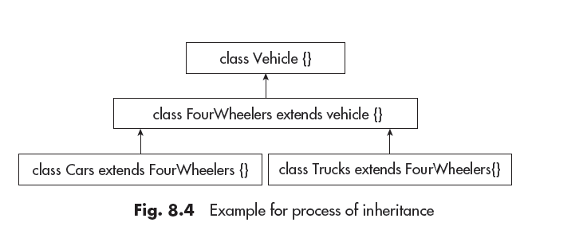
Process of Inheritance

Slide 11
Types of Inheritance
The following types of inheritances are supported by Java.
1. Single inheritance
2. Multilevel inheritance
3. Hierarchical inheritance
4. Multiple inheritance using interfaces

Slide 12
Types of Inheritance
Single inheritance: It is the simple type of inheritance. In this, a class extends another one class only.

Slide 13
Types of Inheritances
(ii) Multilevel inheritance: When a class inherits from another class, and that derived class is further inherited by another class, it is called Multilevel Inheritance.

Slide 14
Types of Inheritances
Hierarchical inheritance: When multiple subclasses inherit from a single superclass, it is called Hierarchical Inheritance.

Slide 15
Types of Inheritances
Multiple inheritance: In this, a class is extending more than one class.
Java does not support multiple inheritance.
This implies that a class cannot extend more than one class.

Slide 16
Types of Inheritances

Slide 17
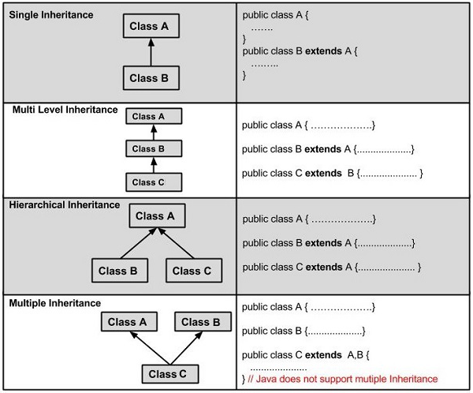
Types of Inheritances

Slide 18
A Super class reference variable can refer to a subclass object.
Also called as upcasting.

Slide 19
Universal Super Class—Object Class
Object class is a special class and it is at the top of the class hierarchy tree.
It is the parent class or super class of all in Java.
Hence, it is called Universal super class.
Object is at the root of the tree and every other class can be directly or indirectly derived from the Object class.

Slide 20
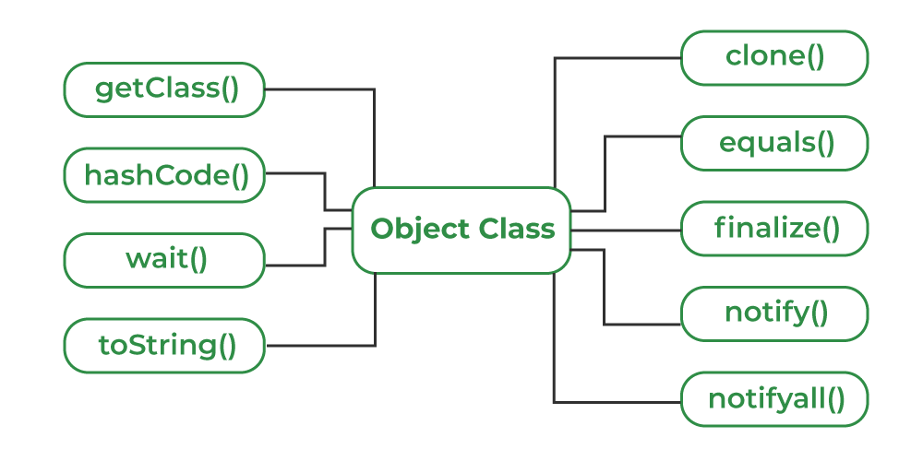
Universal Super Class—Object Class
The default implementation of toString() returns a string that consists of the class name followed by the "@" character and the object's hash code in hexadecimal form

Slide 21
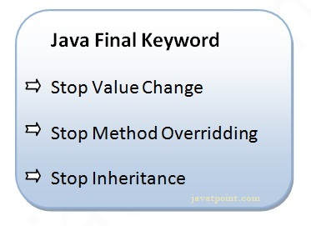
Inehibiting Inheritance of Class using Final
To prevent modifications to the instance variable
To Prevent method overriding
To prevent inheritance
Ex: FinalVariable.java, FinalMethod.java, FinalClass.java

Slide 22
Use of super
Whenever the derived class inherits the base class features, there is a possibility that base class features are similar to derived class features and JVM gets an ambiguity.
The super keyword in Java is a reference variable that is used to refer immediate parent class object.

Slide 23
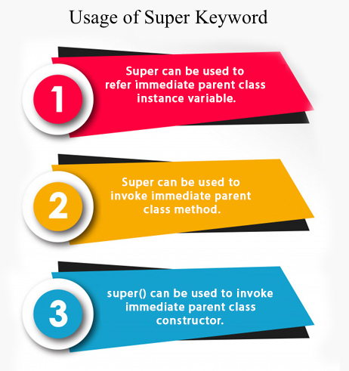
Usage of Java super Keyword
  super is used to refer immediate parent class instance variable.
    super.parent_instance_variable_name;
  super is used to invoke immediate parent class method
    super.parent_class_method_name();
  super is used to invoke immediate parent class constructor.
    super(arglist);
    super(); //default
Super keyword is used to distinguish between the variable/methods having same name in super class and subclass.

Slide 24
Constructor and Inheritance
Constructors of super class are not inherited by sub class but the constructor of the super class can be invoked from sub class using super().
Constructor chaining takes place from bottom to top, while constructor execution takes place from top to bottom.
To establish the connection between base class constructor and derived class constructors JDK provides two constructor statements:
  super()
  super(arglist)

Slide 25
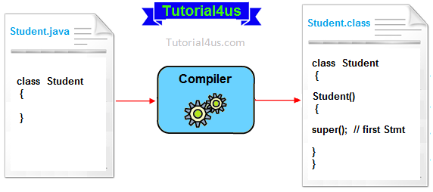
.

Slide 26
Super(...)
Super(...) It is used for calling super class parameterize constructor from the context of derived class constructor.
Important rules
- Whenever we are using either super() or super(...) in the derived class constructors the super always must be as a first executable statement in the body of derived class constructor otherwise we get a compile time error.

Slide 27
Access Control and Inheritance
When a derived class (subclass) inherits from a superclass, the access to superclass members depends on the access specifier used for those members.
Java has four access levels actually:
  public
  protected
  default (no keyword)
  private
The code for specifying access is
access-specifier type member_name;
A public class can inherit all the public and protected members of super class. However, private members are not directly accessible to sub class. These are accessible with public methods of same class.

Slide 29
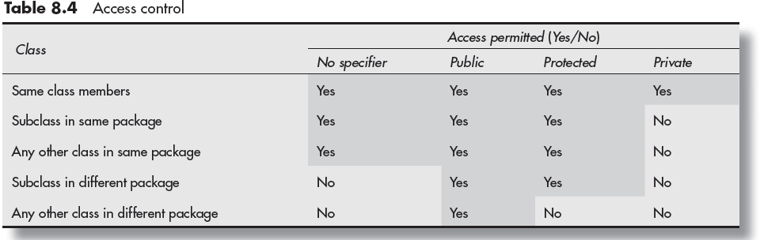

Slide 30
Array of Objects
An array of objects is an array whose elements are references to objects.
Dog300[] dogs = new Dog300[3];
dogs
↓
+--------+--------+--------+
| null | null | null |
+--------+--------+--------+
0 1 2

Slide 31
dogs[0] = new Dog300();
dogs[1] = new Dog300();
dogs[2] = new Dog300();
dogs
↓
+---------+---------+---------+
| Dog | Dog | Dog |
+---------+---------+---------+
0 1 2

Slide 32
Primitive array
  int[] a = new int[3];.
Object array
  Student[] s = new Student[3];
+-----+-----+-----+
| 10 | 20 | 30 |
+-----+-----+-----+
+--------+--------+--------+
| ref | ref | ref |
+--------+--------+--------+
↓ ↓ ↓
Student Student Student

Slide 33
An array of objects is an array that stores references to objects of a particular class.
The objects themselves are created separately using new.

Slide 34
Method Overriding
Method overriding is one of the ways in which polymorphism can be implemented.
Polymorphism – objects take different forms at different environments.
Method Overriding:
  When both super class and sub class contain a method with same name and type signature - then the super class method is overriden by the sub class method.
  When an overridden method is called from within its subclass, it will always refer to the version of that method defined by the subclass. The version of the method defined by the superclass will be hidden.

Slide 35
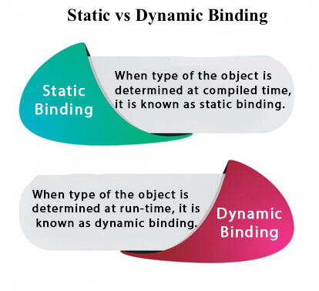
Types of Binding
Connecting a method call to the method body is known as binding.
There are two types of binding:
Static binding / early binding /compile-time
Dynamic binding /late /run-time
Static Binding (also known as Early Binding). –
  When type of the object is determined at compiled time(by the compiler), it is known as static binding.
  If there is any private, final or static method in a class, there is static binding.
Dynamic Binding (also known as Late Binding).
  type of the object is determined at run-time

Slide 36
Dynamic Method Dispatch
Dynamic Method Dispatch is the mechanism by which runtime polymorphism is achieved for overridden methods in Java.
It works on “ A Super class reference variable refers to a sub class object”.
Java uses this fact to resolve calls to overridden methods at run time.
Here is how?:
  When an overridden method is called through a superclass reference, Java determines which version of the method will be executed based upon the type of the object being referred.

Slide 37
Abstract method
An abstract method is a method without definition.
Syntax:
    abstract return_type method_name(parameter_list);

Slide 38
Abstract class
An abstract class is a class that contains one or more abstract methods.
An abstract class can contain instance variables, constructors, concrete methods in addition to abstract methods.
All the abstract methods of abstract class should be implemented in its sub classes.
If any abstract method is not implemented in its subclasses, then that sub class must be declared as abstract.
We can’t create an object to abstract class, but we can create references to abstract class.
Also, you cannot declare abstract constructors or abstract static methods.

Slide 39
QA?
  Can you declare a class as abstract and final?

Slide 40
Interfaces Introduction
An interface is a blueprint/contract that specifies what a class must do.
An interface can contain: Constants (public static final variables) Abstract methods , Default and static methods (with Java 8+),
Nested classes and interfaces.
An interface cannot have instance variables.
Its variables are implicitly public static final.
An interface is implemented by a class using the implements keyword.
Traditionally, abstract methods in an interface do not have a body; they end with a semicolon.
The implementing class must provide the method body for the abstract methods.

Slide 41
interface Animal
{
int legs = 4; // Constant
void sound(); // Abstract method
}
class Dog implements Animal
{
public void sound()
{
System.out.println("Dog barks");
}
}
class Test
{
public static void main(String[] args)
{
Dog d = new Dog();
d.sound();
}
}

Slide 42
Introduction
A class that implements an interface must provide definitions for all abstract methods declared in the interface, unless the implementing class itself is declared abstract.
An interface can be implemented by any number of unrelated classes. Each class can provide its own implementation of the interface methods.
Different classes can provide different implementations of the same interface method. The method signature (name and parameter list) must match the interface declaration, and the return type must be compatible.
Therefore, interfaces support polymorphism. The same interface reference can refer to objects of different implementing classes, and the appropriate overridden method is executed at runtime.

Slide 43
interface Animal { void sound(); } class Dog implements Animal { public void sound() { System.out.println("Dog barks"); } } class Cat implements Animal { public void sound() { System.out.println("Cat meows"); } } | class Test { public static void main(String[] args) { Animal a; a = new Dog(); a.sound(); a = new Cat(); a.sound(); } }

Slide 44
Introduction
From Java SE 8 onwards, an interface can contain default and static methods with complete method definitions (method bodies).
A default method is inherited by the implementing class. The class can override the default method if it needs a different implementation.
A class can implement multiple interfaces. This provides a way to achieve multiple inheritance of behavior/contracts. Java does not allow a class to extend multiple classes.
For example: class C extends A, B // Not allowed
class C implements A, B // Allowed

Slide 45
interface A { default void show() { System.out.println("A's show()"); } } interface B { default void display() { System.out.println("B's display()"); } } | class C implements A, B { // Can use both methods directly } class Test { public static void main(String[] args) { C obj = new C(); obj.show(); obj.display(); } }

Slide 46
Similarities between Interface and Class
Feature | Class | Interface
Declaration | Declared using class keyword | Declared using interface keyword
Variables | Can contain instance, static and local variables | Cannot contain instance variables; variables are public static final constants
Methods | Can contain methods with complete definitions | Can contain abstract methods; default and static methods can have definitions
Object creation | Objects can be created using new | Objects cannot be created directly
Reference variable | Class reference variables are allowed | Interface reference variables are allowed

Slide 47
Inheritance | A class can extend only one class | A class can implement multiple interfaces
Multiple inheritance | Multiple inheritance of classes is not supported | Multiple interfaces can be implemented by a class
Access modifiers | Members can have private, protected, public, etc. | Abstract methods are implicitly public; interface constants are public static final
Constructors | Can have constructors | Cannot have constructors
Abstract methods | Can have abstract methods if the class is abstract | Can have abstract methods
Nested classes, interfaces | Can contain nested classes, interfaces | Can contain nested classes and interfaces
Implementation | A class can extend another class using extends | A class implements an interface using implements
Polymorphism | Supports runtime polymorphism through inheritance | Provides another mechanism for achieving runtime polymorphism

Slide 48
Dissimilarities between Class and Interface
Interface cannot implement itself; it must be implemented by a class.
An interface can contain only method headers followed by a semicolon.
It cannot have the full definition of a method. The full definition is given in the class that implements it.
The methods declared in the interface are implicitly public.
An interface does not contain instance variables.
The variables declared in an interface are implicitly public, static, and final,
Interfaces cannot have a constructor like a class.
An interface cannot extend a class nor can it have a subclass. It can only extend other interfaces.
A class can extend (inherit) only one class but an interface can extend any number of interfaces.

Slide 49
Rules for Classes that Implement Interface
Abstract methods | A non-abstract class that implements an interface must provide concrete implementations of all abstract methods of that interface.
@Override annotation | The @Override annotation can be used on the implementing methods to indicate that they override/implement a method declared in the interface.
default methods | A default method has a complete definition in the interface and is inherited by the implementing class. The class may override it if required.
static methods | A static method has a complete definition in the interface, but it is NOT inherited by the implementing class. It is accessed using the interface name.

Slide 50
interface Animal { void sound(); // Abstract method default void eat() { System.out.println("Animal eats"); } static void info() { System.out.println("Animals are living beings"); } } class Dog implements Animal { @Override public void sound() { System.out.println("Dog barks"); } } | class Test { public static void main(String[] args) { Dog d = new Dog(); d.sound(); // Implemented abstract method d.eat(); // Inherited default method Animal.info(); // Static method } }

Slide 51
Types of Interfaces
Top level interfaces
It is an interface that is not nested in any class or interface.
Nested interface
It is an interface that is defined in the body of a class or interface.
It is referred to by the outer interface or class and cannot be accessed directly.
class X{
interface y{}
}
class A implements X.y { }

Slide 52
Generic interface
We can develop more adaptable and reusable interfaces in Java since an interface can include a generic type parameter.
This is implemented for different data types.
public interface MyInterface<T> {
void doSomething(T value);
}
public class MyClass implements MyInterface<String> {
public void doSomething(String value) {
System.out.println("Doing something with " + value);
}
}
public class AnotherClass implements MyInterface<int> {
public void doSomething(int value) {
System.out.println("Doing something with " + value);
}
}

Slide 53
Declaration of Interface
Declaration of an interface starts with the access modifier followed by keyword interface.
It is in then followed by its name or identifier that is followed by a block of statements;
    These statements contain declarations of variables and abstract methods.
    The variables defined in interfaces are implicitly public, static, and final.
    They are initialized at the time of declaration.
    The methods declared in an interface are public by default.
    Since Java SE8, static and default methods with full definition can also be members of interface.

Slide 54
Declaration of Interface

Slide 55
Implementation of Interface
Syntax:
class classname [extends superclass] [implements interface1 [,interface2...]] {
// class-body
}

Slide 56
Implementation of Interface
Declaration of class that implements an interface
If a class extends another class as well as implements interfaces, it is declared as

Slide 57
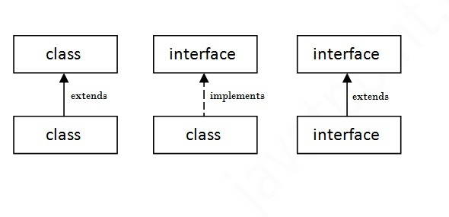
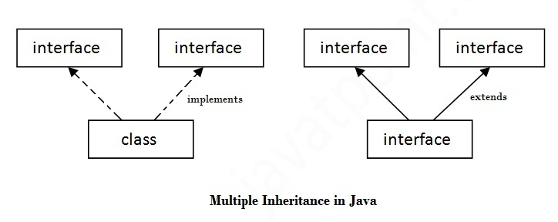
Ex: FindAreas, use of constants

Slide 58
Multiple Interfaces
Multiple interfaces can also be implemented in Java.
For this, the class implements all the methods declared in all the interfaces.
When the class is declared, names of all interfaces are listed after the keyword implements and separated by comma.
As for example, if class A implements interfaces C and D, it is defined as

Slide 59
Interface References
In Java, an interface cannot be instantiated.
Therefore, it cannot be referenced directly.
However, an object of class type, which extends the interface, can be used to assign a reference of that interface type.
    InterfaceReferences.java

Slide 60
Nested Interfaces
An interface may be declared as a member of a class or in another
interface.
In nested concepts interfaces can only be declared as public or with
default access.
Syntax of nested interface in another interface is given as

Slide 61
Inheritance of Interfaces
One interface can inherit another by use of the keyword extends. The syntax is the same as like inheriting classes.
When a class implements an interface that inherits another interface, it must provide implementations for all methods defined within the interface inheritance chain.

Slide 62
Default Methods in Interfaces
Before Java 8, interfaces could have only abstract methods.
The implementation of these methods has to be provided by sub class.
To overcome this issue, Java 8 has introduced the concept of default methods which allow the interfaces to have methods with implementation details.
Default methods are also known as defender methods or virtual extension methods.
These methods can be overridden by implementing classes.

Slide 63
Rules
If a class implements two or more interfaces, the interfaces cannot have default methods with the same signature because this would cause ambiguity as to which one to execute.
In the case of methods with the same name, the compiler would choose by matching parameters.
A default method cannot be declared final.
If an interface A is extended by another interface B and both have a default method with same name, the definition of interface B will be chosen. Otherwise use super keyword.
  Ex:DefaultMethodEx3.java

Slide 64
If a class implements two or more interfaces, the interfaces cannot have default methods with the same signature because this would cause ambiguity as to which one to execute.
  interface A {
  default void show() {
  System.out.println("A's show()");
  }
  }
  interface B {
  default void show() {
  System.out.println("B's show()");
  }
  }
  class C implements A, B {
  // Compilation error unless show() is overridden
  }
So, the class must override the method:
class C implements A, B {
public void show() { System.out.println("C's show()");
}
}

Slide 65
Inheritance between interfaces
  Suppose interface B extends interface A, and both have a default method with the same signature.
  interface A {
  default void show() {
  System.out.println("A's show()");
  }
  }
  interface B extends A {
  default void show() {
  System.out.println("B's show()");
  }
  }
  class C implements B {
  }
Now there is no ambiguity.
C obj = new C();
obj.show();
Output:
B's show()
Why?
B is a subinterface of A, so B's default method is more specific and overrides A's default method.

Slide 66
Calling the parent interface's default method using super
  interface A {
  default void show() {
  System.out.println("A's show()");
  }
  }
  interface B extends A {
  default void show() {
  System.out.println("B's show()");
  A.super.show();
  }
  }
  O/p:
  B's show()
  A's show()
Synatx:
A.super.show();

Slide 67
Static Methods in Interface
The Java version 8 allows full definition of static methods in interfaces.
The interfaces can have static methods which is similar to static method of classes.
Can be referred with interface names.
Interfacename.staticmethodname();
NOTE: Static interface methods are not inherited by either an implementing class or subinterface
These methods can not be overridden by classes or interfaces. Where as a default methods can be overridden.

Slide 68
Interface vs. Abstract Class
Feature | Interface | Abstract Class
Declaration | interface | abstract class
Purpose | Defines a contract / common behavior | Provides partial implementation
Abstract methods | Yes | Yes
Concrete methods | Yes (default, static methods) | Yes
Instance variables | No | Yes
Variables | public static final by default | Can be instance, static, final, etc.
Constructor | No | Yes
Object creation | Cannot create directly | Cannot create directly
Inheritance keyword | implements | extends
Multiple inheritance | A class can implement multiple interfaces | A class can extend only one class
Access modifiers for abstract methods | Public by nature | Can have different access levels
Nested classes | Yes | Yes

Slide 69
Use of toString()
The toString() method returns the String representation of the object.
If you print any object, Java compiler internally invokes the toString() method on the object.
System.out.println(obj);
So overriding the toString() method, returns the desired output, it can be the state of an object etc. depending on your implementation.

